Slide 1
Lecture 5
2 Dimensional Transformations
Translation x’=x + tx
y’=y + ty
Where tx and ty are translation factors
Scaling x’=x * sx
y’=y * sy
Where tx and ty are translation factors
Rotation x’=xcos@ + ysin@
y’=xsin@ - ycos@
Where @ is the rotation angle of the given point

Slide 2
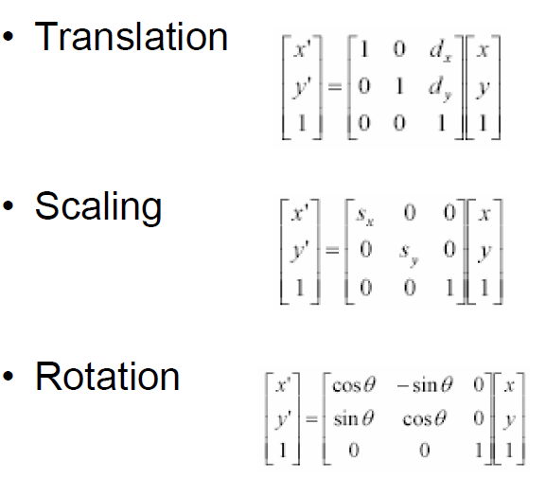
2D Transformation in Homogenous Notation

Slide 3
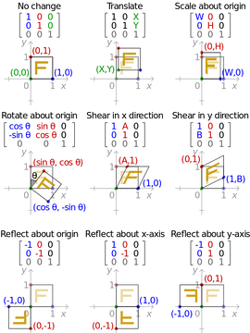

Slide 4
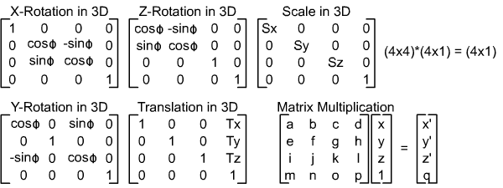
3D Transformation in Homogenous Notation

